Slide 1

ESA Humanitarian Relief Fund

Slide 2
HRF Sustainability and Autonomy
Who we are?
The ESA Humanitarian Relief Fund (HRF) founded in ESTEC with the purpose to offer its working community the possibility of helping people in distress and giving a helping hand for communities struggling to improve.
What we do?
Our aim is to help people in distress and poor living conditions by raising charitable donations for relief and development projects in developing countries.
Sustainability and autonomy is our long term goal
We ensure that support to projects is sustainable and that autonomy of the affected groups is strongly encouraged
HRF ensure that money arrives directly to the people by having direct contact with a person in the place, following up the progress and the expenses

Slide 3
Our team of volunteers
Chiara Lombardi, Jinesh Ramachandran, Linda Robbins, Ajantha Ambily, Amadou Whittaker, Bernard Guillaume, Eliseo Balaguer, Filippo Concaro
Michele Armano, Donny Aminou, Anna Fogtman,
Kasia Osuch, Lalit Golani, Shamim Hartevelt,
Annalisa Galeone, Marie-Pierre Budin,
Caroline Prost, Claudia Paparini,
Christophe Audin, Beatriz Moreno,
Arathy Sarangadharan,
Manon Gautier, Tom Meinert
Inigo Alonso Etxebarria,
Mona Delgado,Yanina Sulleiro
Contact us at ESA.HRF.COMMITTEE@ESA.INT
IBAN: NL23 ABNA 0515 7876 55
http://www.humanrelieffund.com
BECOME A VOLUNTEER,
MAKE SPACE FOR HELP

Slide 4
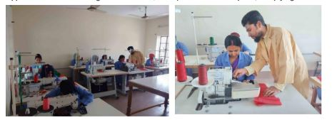
Funded Projects 2023
PAF 136
LichtBruecke: renewal of technical equipment and tools for vocational training/trade courses to provide up-to-date education in Bangladesh (Bangladesh)
2nd instalment
Donation €2,668.30

Slide 5
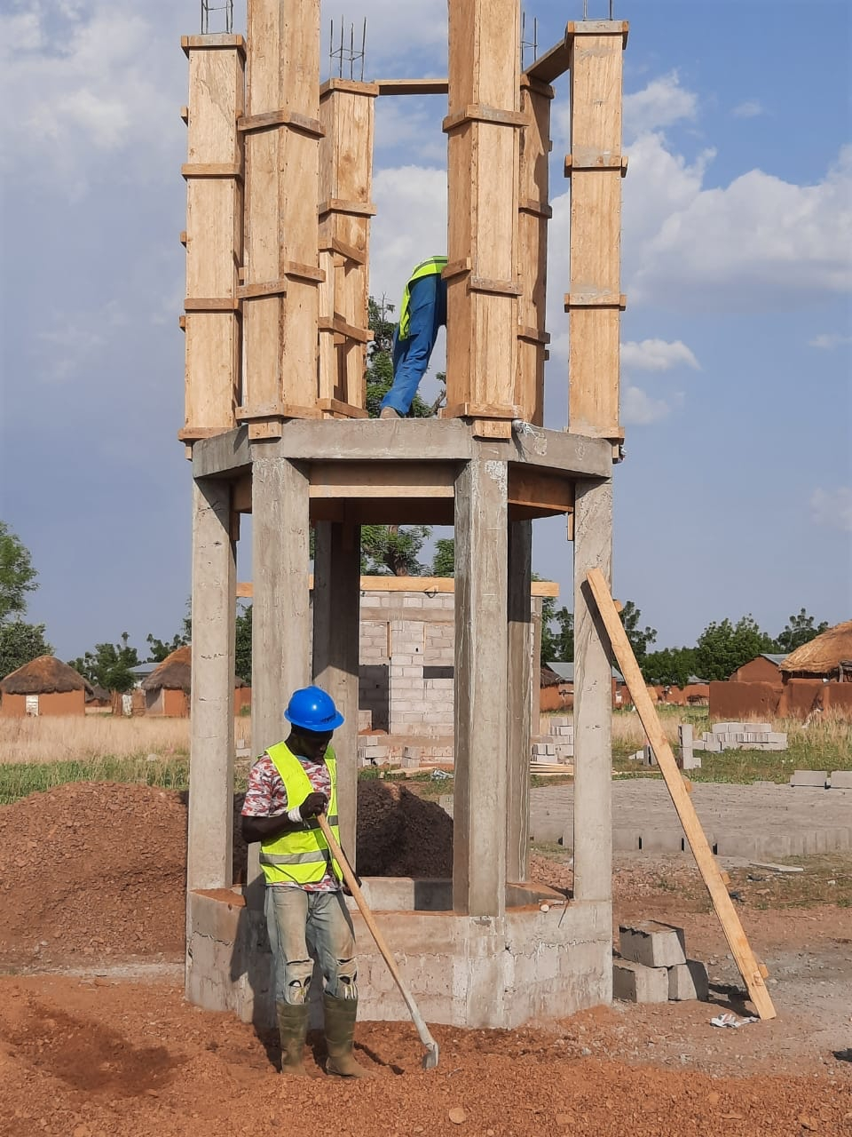
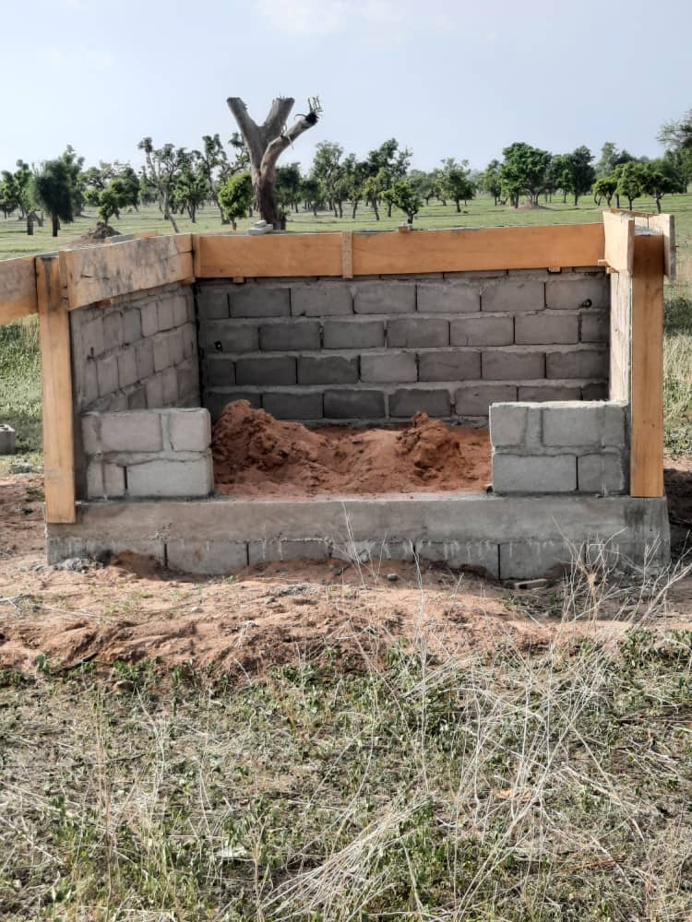
Funded Projects 2023
PAF 141
Ecole Pour Tous: Schools Water Drilling to access clean water (Cameroon) 2nd instalment
Donation €7,000

Slide 6
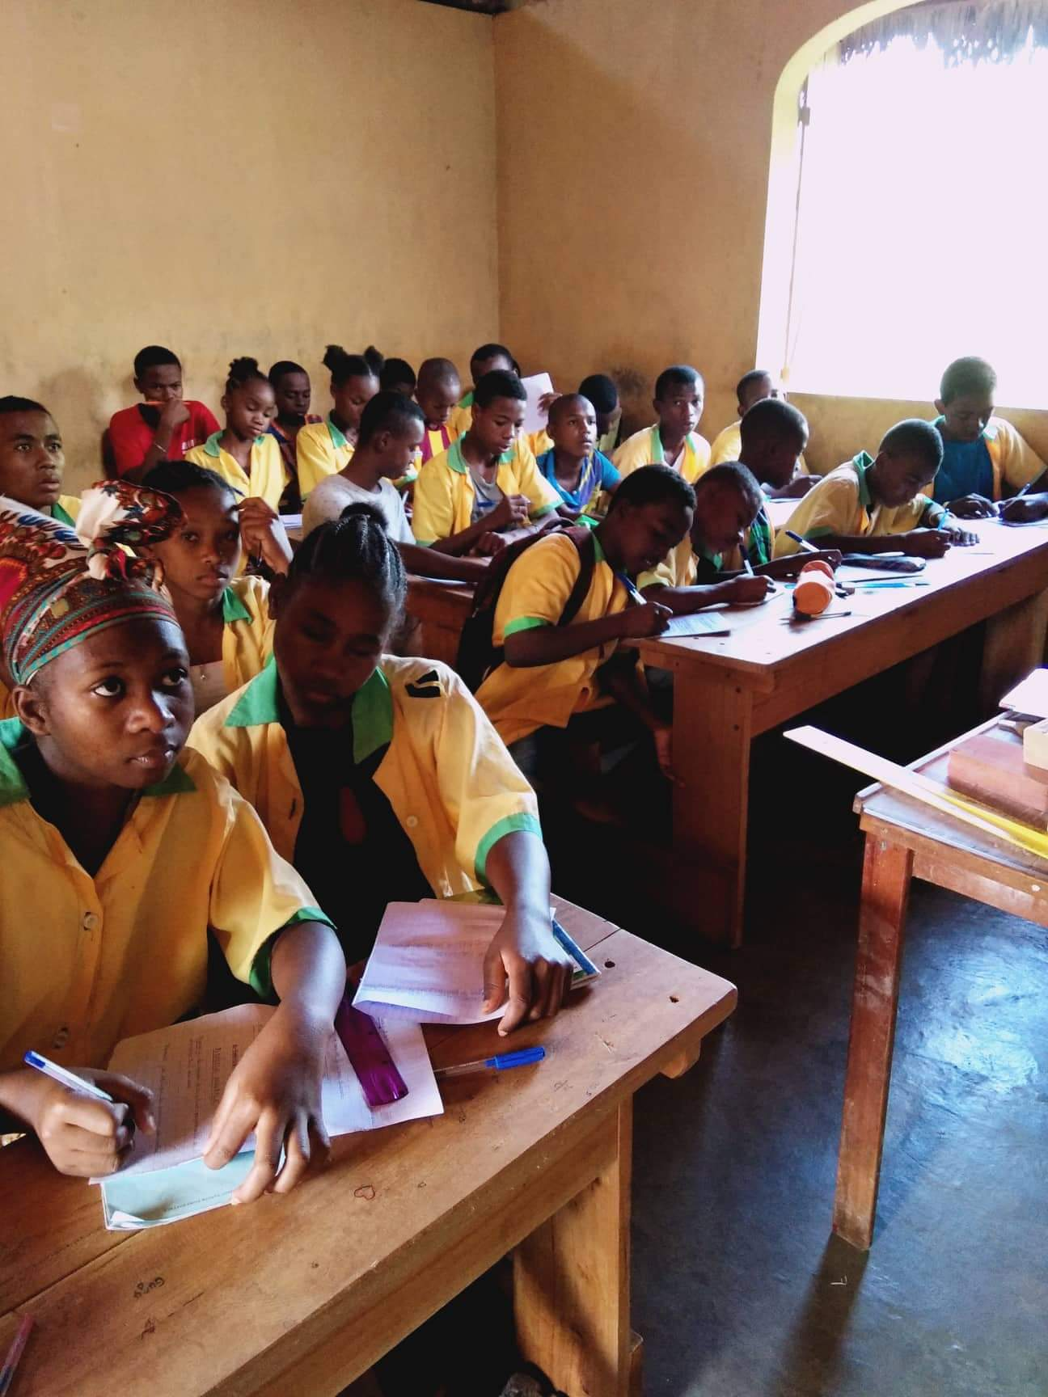
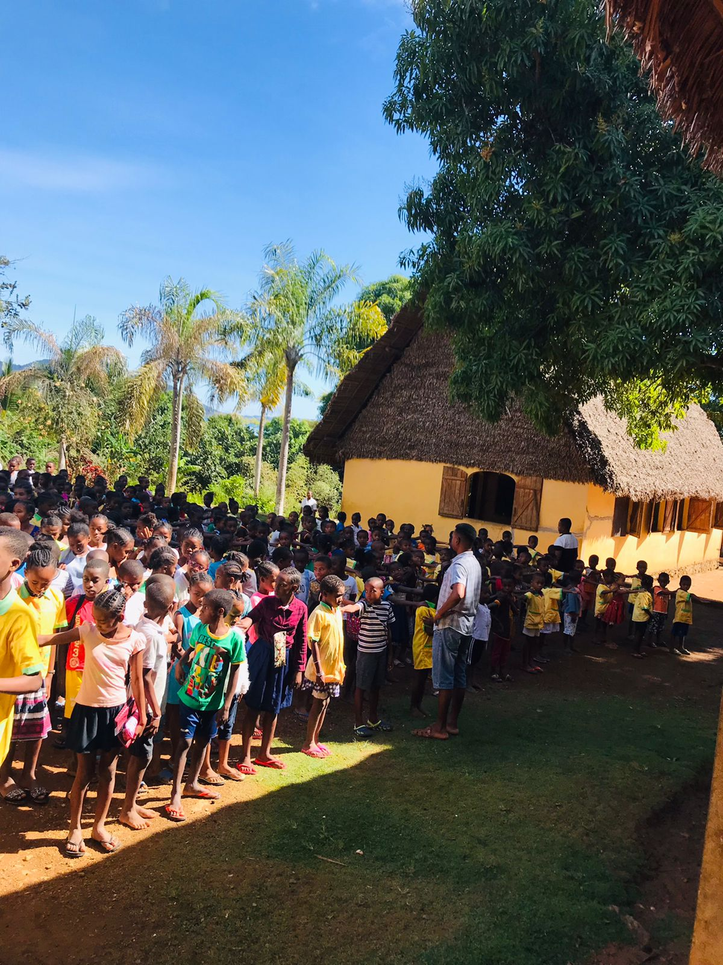
Funded Projects 2023
PAF 142
Sunshine in Nosy Komba: Education Project Ecole Banana (Nosy Komba)
Donation €4,000

Slide 7

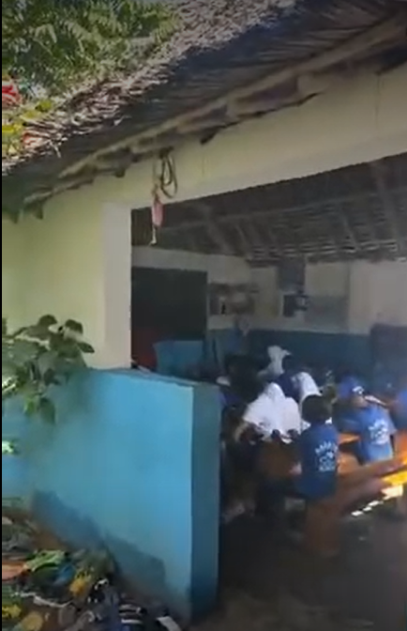
Funded Projects 2023
PAF 143
Sister Island: New school class to be built at the existing nursery school building (Zanzibar)
Donation €5,093

Slide 8
Funded Projects 2023
PAF 144
Bridge2Hope: Rental costs of the community centre
Donation €4,724

Slide 9
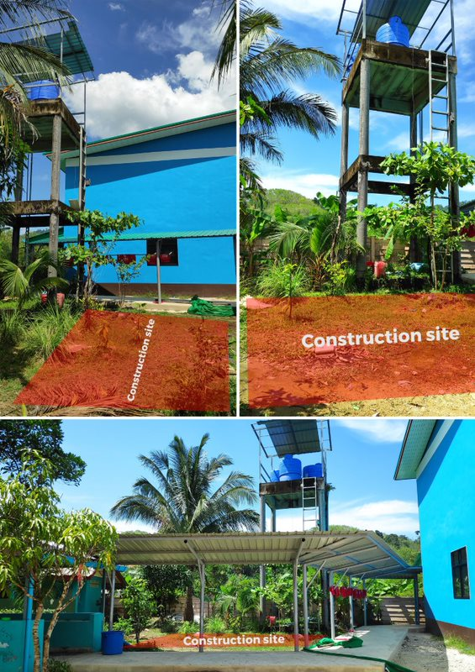
Funded Projects 2023
PAF 145
Foundation for Educational Development: Clean Drinking Water & Durable Bottles for 600+ Children (Thailand)
Donation €3,400

Slide 10

Funded Projects 2023
PAF 148
Me to You Charity: Food and medicine drive to 2 villages (Kenya)
Donation € 5000

Slide 11
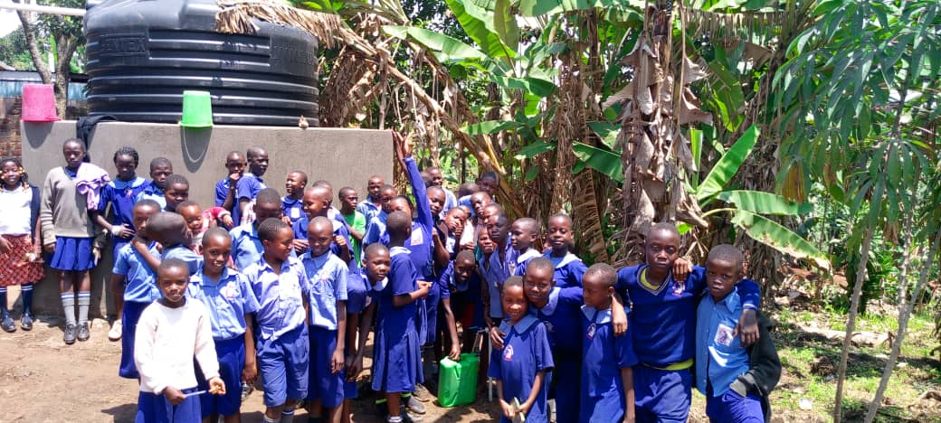
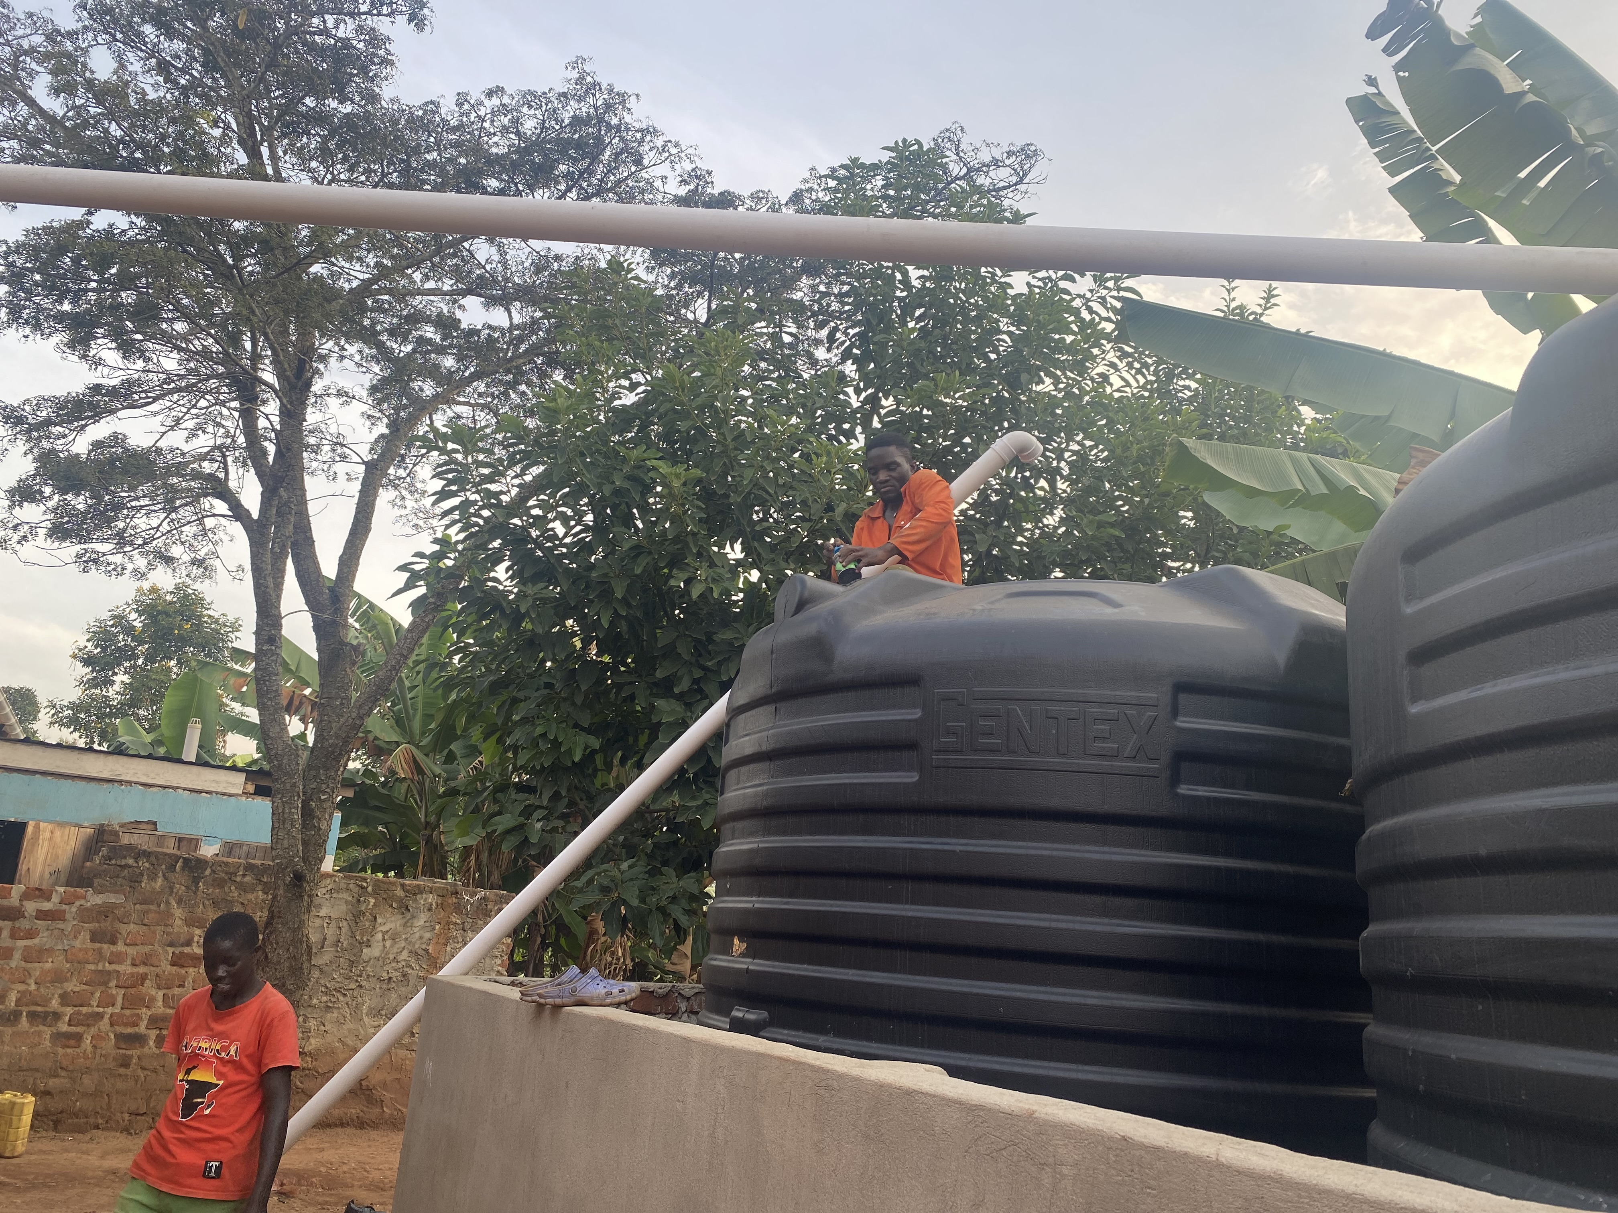
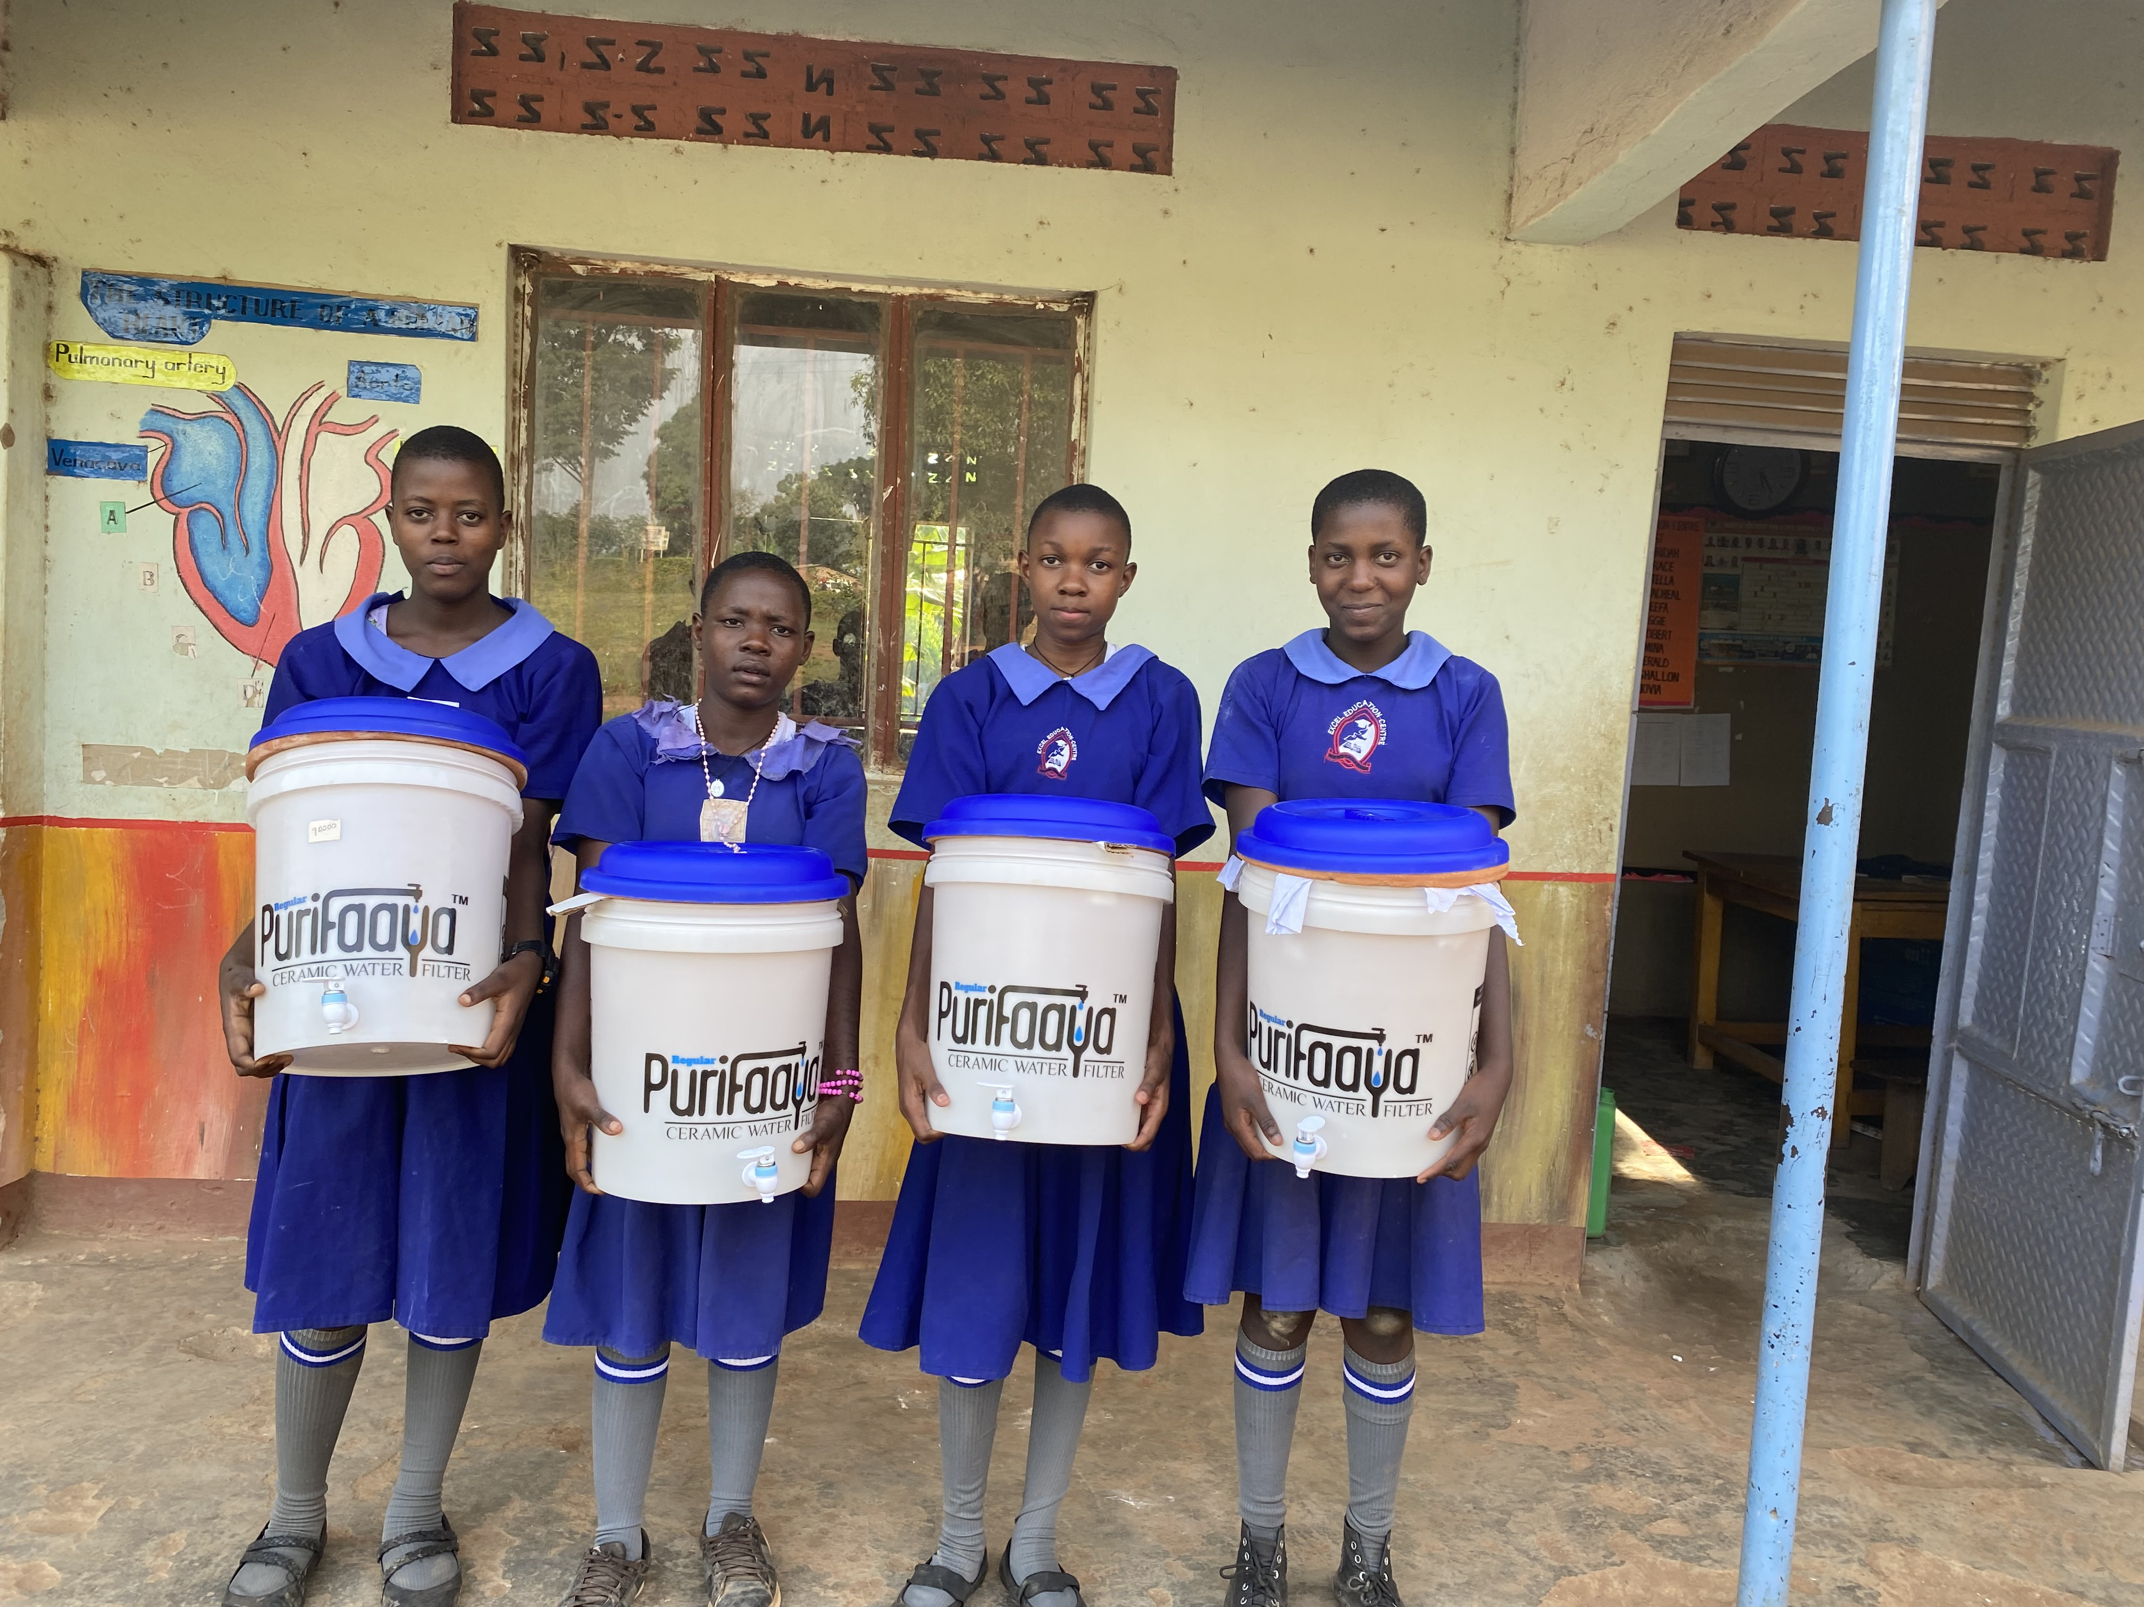
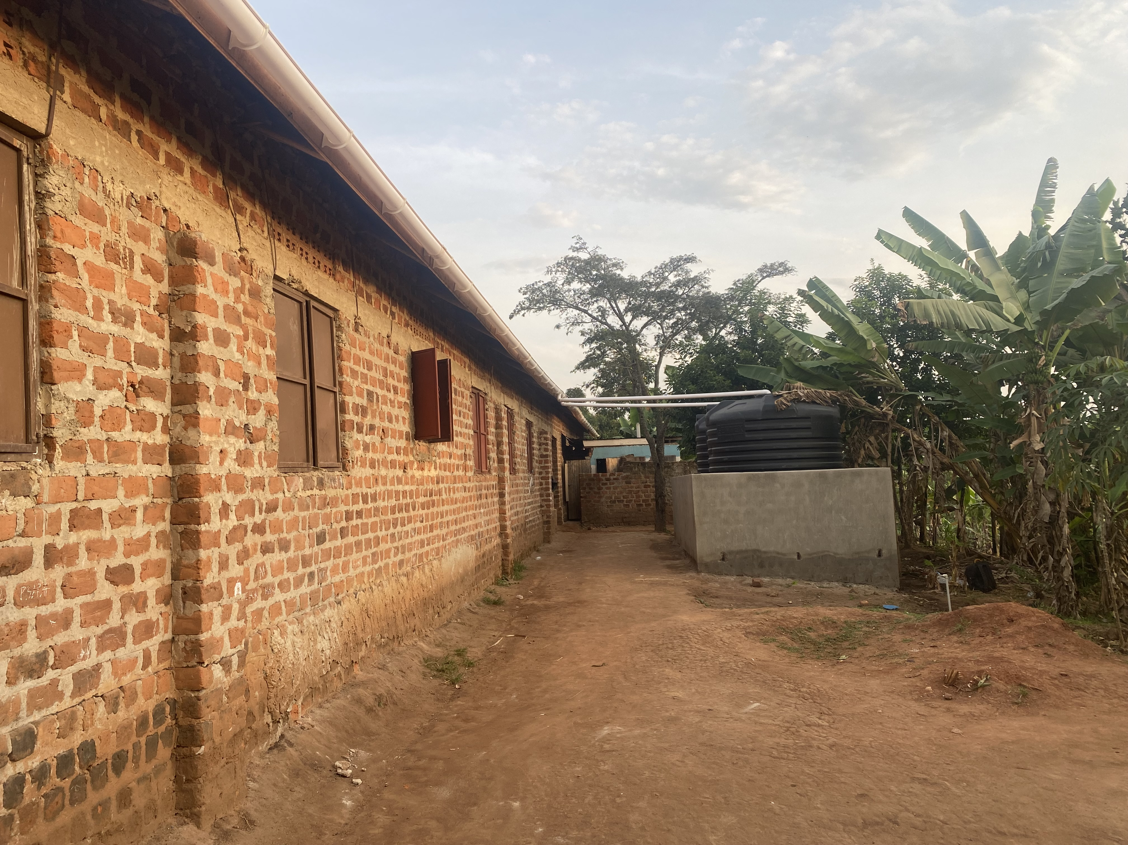
Funded Projects 2023
PAF 149
Youth and Women Initiative for Sustainable Development: Water tanks (Uganda)
Donation € 3635

Slide 12
Funded Projects 2023
PAF 150
Naledi Initiative: Hydrogeological feasibility study / survey (Kenya)
Donation € 700

Slide 13
Funded Projects 2023
PAF 151
EmpowHER: Women tailoring project (Kenya)
Donation € 5000

Slide 14

ACTION: Help Turkey & Syria

Slide 15
ACTION: Help Turkey & Syria
AHBAP - Donation €2,500
Artsen zonder grenzen - Donation €2,500
With your help via Tikkie:
MSF Syria - Donation €5,000
AHBAP- Donation €6,000
Darüşşafaka - Donation €6,000

Slide 16
ACTION: Help Italian floods victims
Emilia Romagna Protezione Civile - Donation €4,000

Slide 17
ACTION: Help Greece
Hellenic Red Cross - Donation €4,000

Slide 18
ACTION: Help Libya
United Nations Population Fund - Donation €4,000

Slide 19
ACTION: Help Morocco
Association les chemins du coeur - Donation €4,000

Slide 20
ACTION: Help Gaza
Artsen zonder grenzen - Donation €5,000

Slide 21
TOTAL DONATIONS 2023: EUR 84,655.80
Creditor | Description | Donated
Sunshine in Nosy Komba | PAF 142: Education project Ecole Banana (Nosy Komba) | €4,000.00
Sister Island | PAF 143: Sister Island (Zanzibar) / 1st payment | €2,500.00
Bridge2Hope | PAF 144: Rental costs of the community center / 1st payment | €2,420.00
AHBAP | NDF - Turkey action | €2,500.00
Artsen zonder grenzen | NDF - Turkey action | €2,500.00
Foundation for Educational Development | PAF 145: Sustainable Clean Drinking Water (Thailand) | €3,400.00
AHBAP | NDF - Turkey action | €6,000.00
Darussafaka | NDF - Turkey action | €6,000.00
Artsen zonder grenzen | NDF - Syria action | €5,000.00
Me to You Charity | PAF 148: Menstrual hygiene management campaign (Kenya) | €5,000.00
Lichtbruecke | PAF 136: Education (Bangladesh) / 2nd payment | €2,668.30
Youth and Women Initiative for Sustainable Development | PAF 149: Water tanks (Uganda) / 1st payment | €2,185.00
Naledi Initiative | PAF 150: Hydrogeological survey (North Kenya) | €700.00
Emilia Romagna Protezione Civile | NDF - Italian floods action | €4,000.00
Kadowinja | Goods for sale (invoice 2301) | €507.50
Bridge2Hope | PAF 144 / 2nd payment | €1,672.00
Youth and Women Initiative for Sustainable Development | PAF 149 / 2nd payment | €1,450.00
United Nations Population Fund | NDF - Libya | €4,000.00
Association les chemins du coeur | NDF - Morocco | €4,000.00
Hellenic Red Cross | NDF - Greece | €4,000.00
La Maison sans frontieres | Goods for sale | €560.00
Artsen zonder grenzen | NDF - Gaza | €5,000.00
Sister Island | PAF 143 / 2nd payment | €2,593.00
Ecole pour Tous | PAF 141 / 2nd payment | €7,000.00
EmpowHER | PAF 151: Women tayloring project (Kenya) | €5,000.00
 | TOTAL DONATED in 2023 | €84,655.80

Slide 22

Thanks!
Heartfelt thanks goes to…
ALL of YOU who are regularly donating to HRF, helping HRF with special donations and to raise awareness!

